Slide 1
FSM 2 : Finite State Machines
©Copyright CHUA DINGJUAN. All rights reserved.

Slide 2

Let’s Try This Out…
Bob is stressed out as he has too many deadlines and isn’t sleeping enough! He has decided to develop a FSM to regulate his time between sleeping and studying.
When he is idle, there are two actions he can do next : SLEEP or STUDY.
To prevent exhaustion, he buys a body exhaustion sensor and checks it every hour. When he is exhausted, the sensor output EX will be TRUE.
When he is exhausted, he should sleep (SLEEP is TRUE). When he is not exhausted, he should study (STUDY is TRUE).
Implement his FSM using D Flip Flops and gates.

Slide 3
Step 1 : Block Diagram, STD
1) Block Diagram
2) State Transition Diagram
Idle
Sleep = 0
Study = 0

Slide 4
Step 2 : Next State Table
State Transition Diagram
Current State | Input | Next State
S |  | S+
S₁S₀ | EX | S₁+S₀+
State | S₁S₀
 | 00
 | 01
 | 10

Slide 5
Step 2 : Next State Table
S₁S₀ | EX | S₁+S₀+
0 0 | 0 | 1 0
0 0 | 1 | 0 1
0 1 | 0 | 1 0
0 1 | 1 | 0 1
1 0 | 0 | 1 0
1 0 | 1 | 0 1
D₁=
D₀=
D₁ :
D₀ :
S₁S₀
S₁S₀
 | 00 | 01 | 11 | 10
0
1
 | 00 | 01 | 11 | 10
0
1
EX
EX
S₁+ =
S₀+ =
*Minimum area vs minimum risk implementations

Slide 6
Step 2 : Next State Table
If the state assignments were to change, would the next state logic change?
S₁
EX
D Q
S₀
D Q
CLK

Slide 7
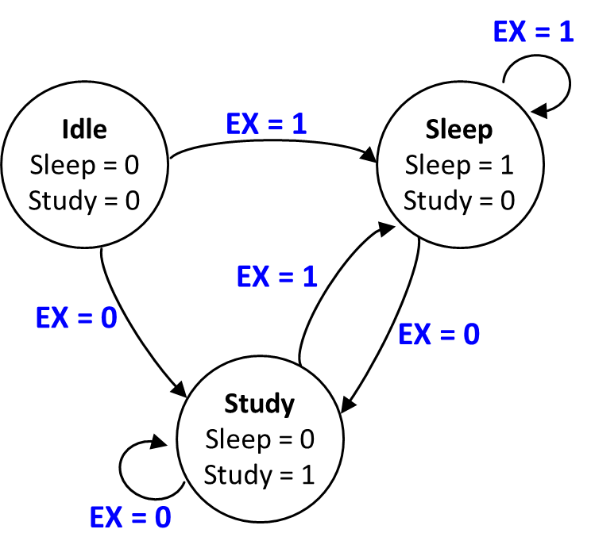
Step 3 : Output Logic
State | S₁S₀
IDLE | 00
SLEEP | 01
STUDY | 10
S₁S₀ | Sleep | Study
0 0
0 1
1 0
Sleep =
Study =
S₁
EX
D Q
S₀
D Q
CLK

Slide 8

Changing Sleep Time…
Bob has decided that he is sleep state for too long and has decided to fix his sleep time to 5 hours. How can we modify his state transition diagram?
Idle
Sleep = 0
Study = 0
EX = 1
Sleep
Sleep = 1
Study = 0
EX = 0
EX = 1
Study
Sleep = 0 Study = 1
EX = 0

Slide 9
Modular Design of FSMs
Designing complex FSMs is often easier if they can be broken down into simpler FSMs that interact.
Idle
Sleep = 0
Study = 0
EX = 1
Sleep
Sleep = 1
Study = 0
Sleep
Sleep = 1
Study = 0
Sleep
Sleep = 1
Study = 0
EX = 0
EX = 1
Study
Sleep = 0 Study = 1
Sleep
Sleep = 1
Study = 0
Sleep
Sleep = 1
Study = 0
EX = 0
Bob FSM
Sleep FSM

Slide 10
Modular Design of State Machines
Submachine 1
Main Machine
START1
DONE1
Inputs
Outputs
START2
Submachine 2
DONE2
Main machine : executes main algorithm, controls the submachines & get the job done. Commands & gets feedback signals from submachines.
Submachines respond to external inputs & commands from main machine. Can give outputs as well as feedback to the main machine.
Common examples of submachines are counters, shift registers, etc.
Sometimes the main machine is called the controller and the submachines are called controlled circuit elements or architectural elements.
Trick here is to modularize appropriately, and pick suitable components for the submachines that simplify the design problem.

Slide 11
Modularizing…
What is a natural submachine that we can use?
Bob FSM
(Main Machine)
STUDY
EX
Sleep FSM
(Submachine)
SLEEP
mod-10
CLR
CLR_C1
TC
1
What inputs would you provide? What outputs would you want?
CLK
Mod- Counter
CLK

Slide 12
Modified FSM
Bob FSM
STUDY
Bob FSM
EX
SLEEP
Done
Clear
Idle
Study = 0
Sleep = 0
Sleep
Study = 0
Sleep = 1
Clear = 0
EX = 1
Sleep FSM
Done = 1
Sleep FSM
EX = 0
EX = 1
Done = 0
Mod-5 Counter
Clear
Done
Study
Study = 1 Sleep = 0
CLK
EX = 0
Done = 1 when count = 4 (100)

Slide 13
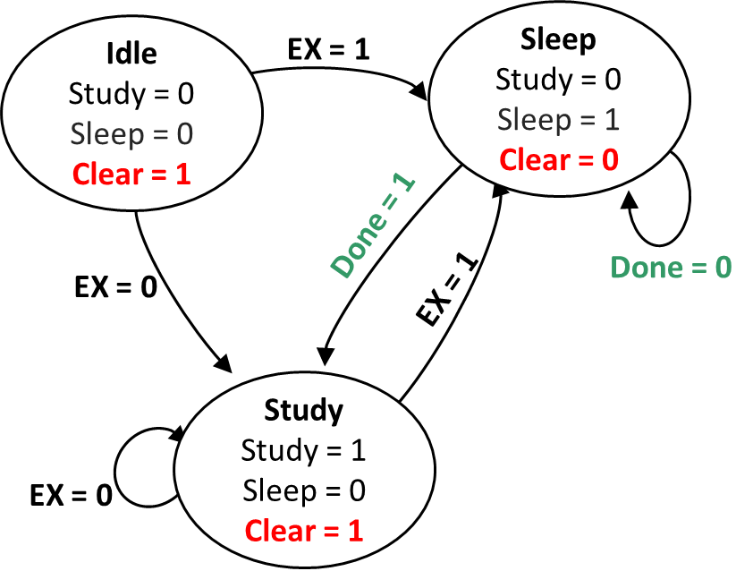
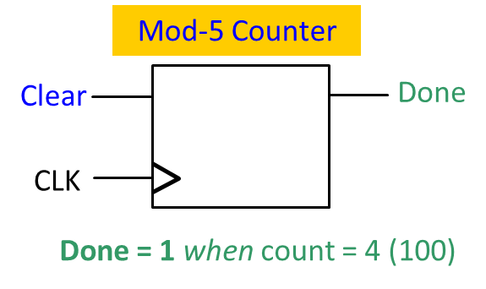
Fill in the timing diagram for Bob FSM and the counter.
CLK
State
Idle
Sleep
Input EX
Sleep
Clear
Count
000
Done

Slide 14
Timing Diagram:
CLK
State
Idle
Sleep
Sleep
Sleep
Sleep
Sleep
Study
Study
Input EX
Sleep
Clear
Count
000
000
001
010
011
100
?
000
Done

